Slide 1


Embedded Antenna Design Based on Zero and Pole Resonances for Wireless Sensor Modules for Applications in Advanced Greenhouses
Chun-Chih Liu, Shih-An Yang, Tzu-Heng Cheng, and Shih-Yuan Chen
Graduate Institute of Communication Engineering, National Taiwan University, Taipei, Taiwan
Email: shihyuan@ntu.edu.tw
National Taiwan University

Slide 2
Outline
S.-Y. Chen, NTU; shihyuan@ntu.edu.tw
Introduction
Wireless sensor module
Proposed embedded antenna design
UHF RFID system & tag antenna
Tag antenna design based on zero & pole resonances
Antenna performance
Preliminary measurement results
Conclusions

Slide 3

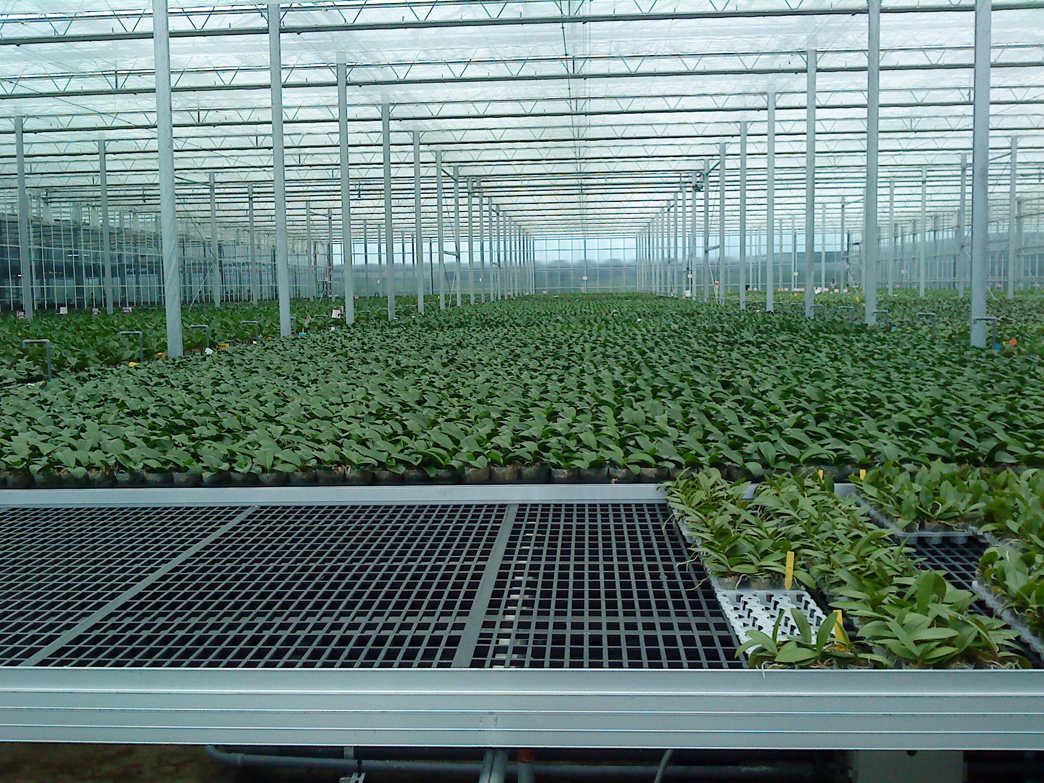
Motivation
S.-Y. Chen, NTU; shihyuan@ntu.edu.tw
Climate change & global warming
Extreme weathers: typhoons, hurricanes, tornadoes, floods, droughts, etc
Direct impact: agricultural losses
Advanced greenhouses
Energy efficient
Environmental factor monitoring
Cost effective

Slide 4
Motivation
S.-Y. Chen, NTU; shihyuan@ntu.edu.tw
Environmental factors to be monitored
Temperature
Relative humidity
Illumination
CO2 …
Requirements: energy-efficient, low-cost, easy-for-maintenance/deployment infrastructure
Solution: wireless sensor modules with low-power consumption → extended battery life or battery-free

Slide 5
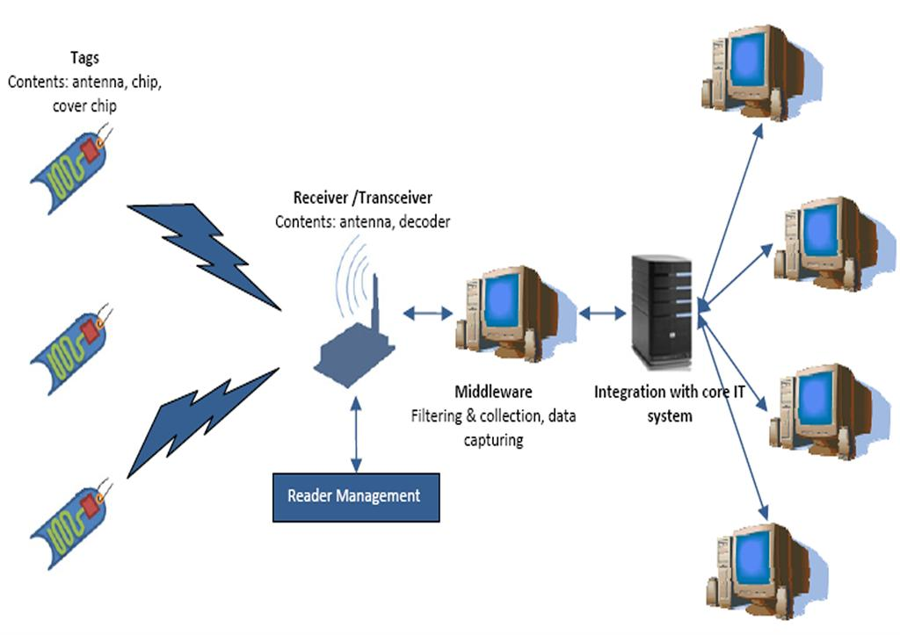
Motivation
S.-Y. Chen, NTU; shihyuan@ntu.edu.tw
Wireless sensor modules with low-power consumption
Passive RFID system
Low cost
Wireless
No power needed in “passive” tags
EPC standard supporting up to 128-bit data transfer/storage
RFID Tags + sensors
RFID Reader

Slide 6
Wireless sensor module
S.-Y. Chen, NTU; shihyuan@ntu.edu.tw
EPC code: serial #, temperature, humidity, … e.g. 0001 0026 0053 0000 0000 0000
Gen2 interface
Proposed design
RFID Tag ANT
Energy-harvesting
part still in progress
- Memory bank
- Totally passive
RFID Tag IC:
Impinj MonzaX-2K Dura
ANT
I2C interfaces
Rectifier
Temp./Humid. sensor: Silicon Labs Si7021
MCU:
TI MSP430G2553
Coin battery

Slide 7
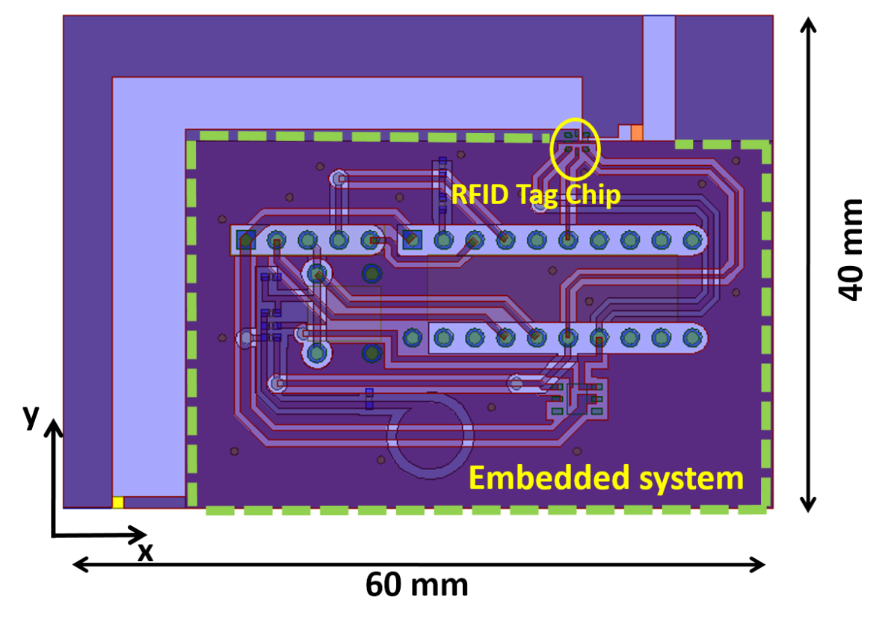
PCB layout of the module
S.-Y. Chen, NTU; shihyuan@ntu.edu.tw
Overall size: 60 × 40 mm²
Antenna-excluded size: 50 × 30 mm²
Double-sided FR4 slab
RFID tag IC: IPJ_MonzaX-2K_Dura
MCU: TI MSP430G2553
Temp./Humd. sensor: Silicon Labs Si7021
Coin battery: CR2032
MCU
Temp./Humd. sensor

Slide 8
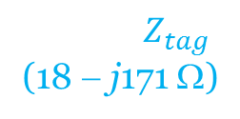
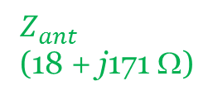
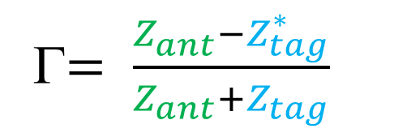
Design requirements of embedded antenna
S.-Y. Chen, NTU; shihyuan@ntu.edu.tw
Complex conjugate match between tag IC & tag antenna to achieve max. power transfer.
Scattered & randomly oriented → omnidirectional
Max. read range r
Γ$= \frac{Z_{ant}^{}−Z_{tag}^{∗}}{Z_{ant}+Z_{tag}}$
RFID Tag ANT
RFID Tag
Chip
$$Z_{tag}$$
(18 − j171 Ω)
$$Z_{ant}^{}$$
(18 + j171 Ω)
Max. EIRP: 4 W @910 MHz by FCC
$$S_{tag}=P_{t}G_{t}G_{r}\left(1−{\left|Γ\right|}^{2}\right)({\frac{λ}{4πr})}^{2}=EIRP×G_{r}\left(1−{\left|Γ\right|}^{2}\right)({\frac{λ}{4πr})}^{2}$$

Slide 9
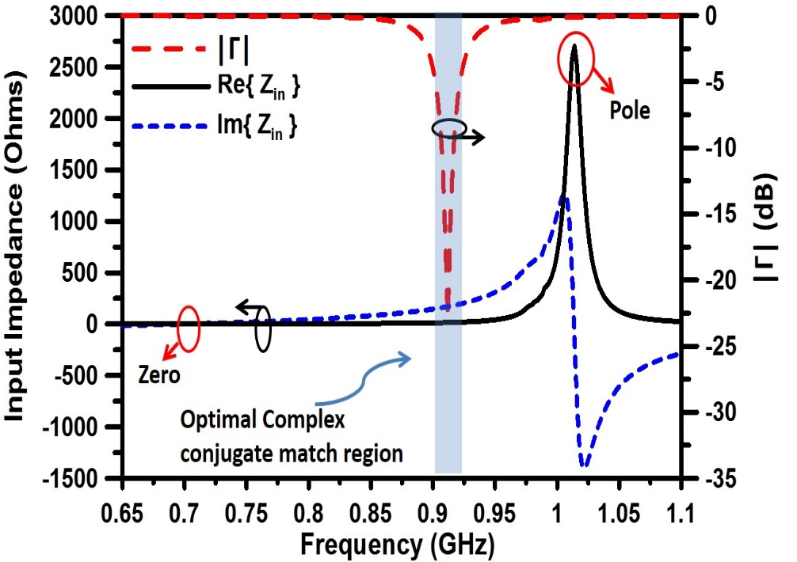
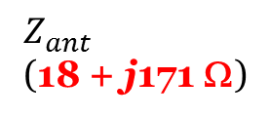
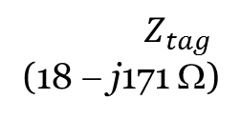
Design method for complex conjugate match
S.-Y. Chen, NTU; shihyuan@ntu.edu.tw
Design goal: small real part & large imaginary part
Zero resonance: lower the real part of Z_{ant}
Pole resonance: increase the imaginary part of Z_{ant}
Ideal resonance arrangement
RFID Tag ANT
RFID Tag
Chip
$$Z_{tag}$$
(18 − j171 Ω)
$$Z_{ant}^{}$$
(18 + j171 Ω)

Slide 10
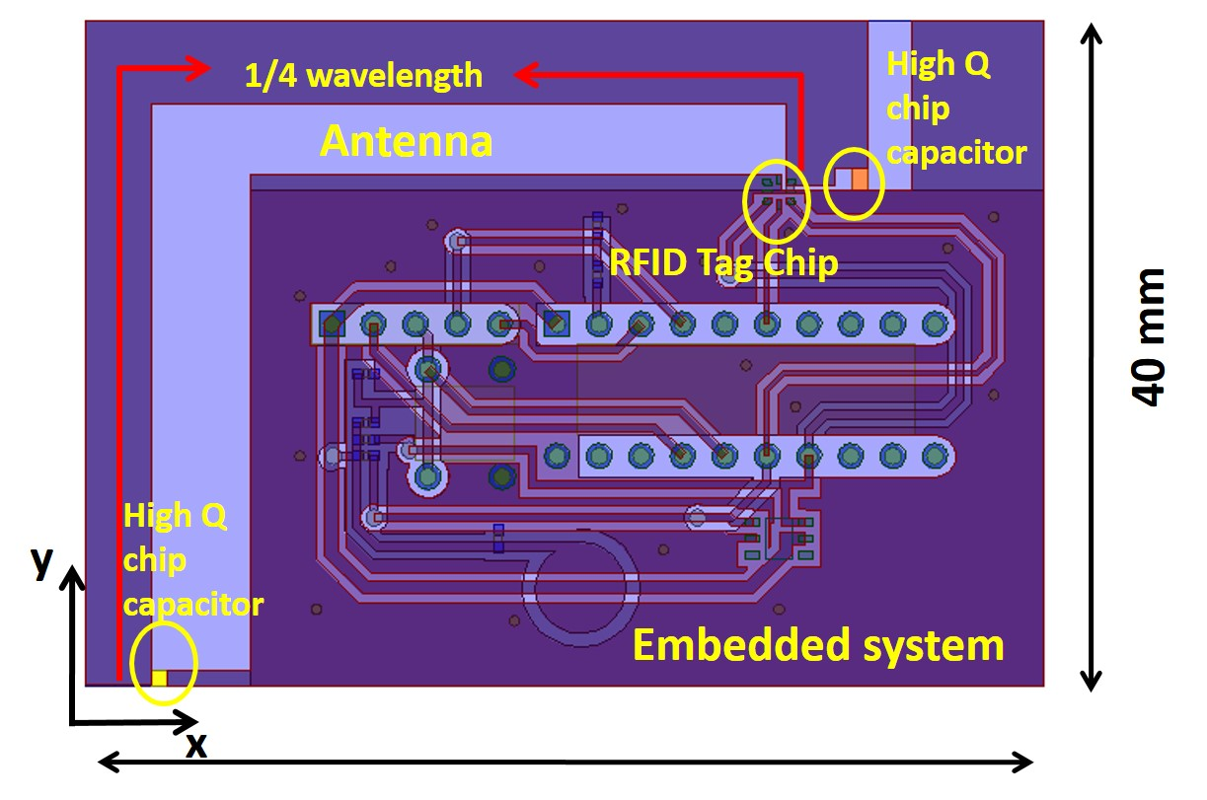
Embedded antenna design
S.-Y. Chen, NTU; shihyuan@ntu.edu.tw
Antenna structure: λ/4 monopole loaded with 2 high-Q chip capacitors (C1 & C2)
Zero resonance: created by λ/4 monopole & can be controlled by C₁, which changes the open-circuit BC.
Pole resonance: created by inductive part of zero resonance & shunt C₂ at higher frequencies.
C₂
C₁

Slide 11
Embedded antenna design
S.-Y. Chen, NTU; shihyuan@ntu.edu.tw
Formation of two resonances (Z- & Y-domain)
Im{Z_{ant}}
Im{Y_{ant}}
Freq.
Freq.
Zero resonance by ¼ wavelength monopole
Pole resonance by zero resonance &
Shunt C₂
Zero resonance by ¼ wavelength monopole
Im{Y_{ant}}
Im{Z_{ant}}
Shunt C₂
+jωC₂ in Y-domain
Freq.
Freq.

Slide 12
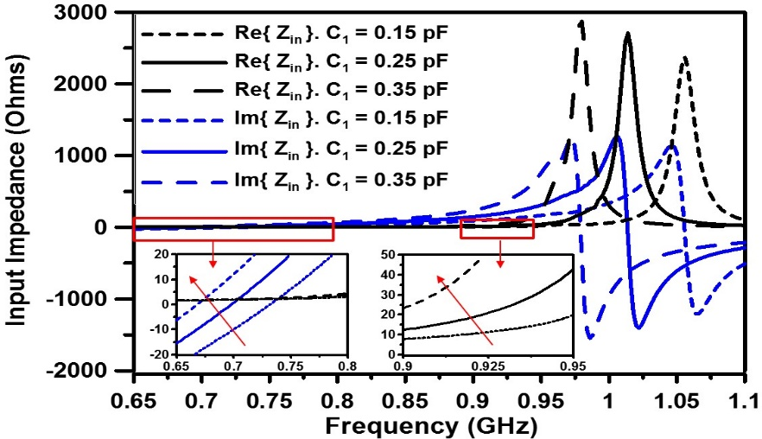
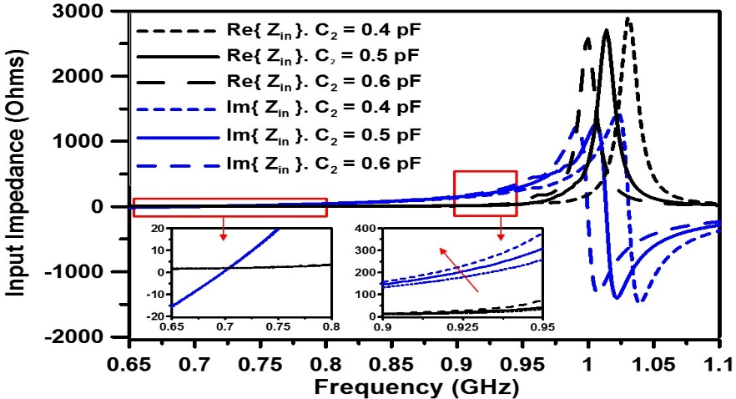
Embedded antenna design
S.-Y. Chen, NTU; shihyuan@ntu.edu.tw
Use C₁ & C₂ to tailor Z_{ant}
18 Ω as C₁ = 0.25 pF
C₂
+j171 Ω as C₂ = 0.5 pF
C₁

Slide 13
Embedded antenna design
S.-Y. Chen, NTU; shihyuan@ntu.edu.tw
Power reflection coefficient when C₁ = 0.25 pF & C₂ = 0.5 pF
−6 dB bandwidth: 902-922 MHz (20 MHz)
C₂
C₁

Slide 14
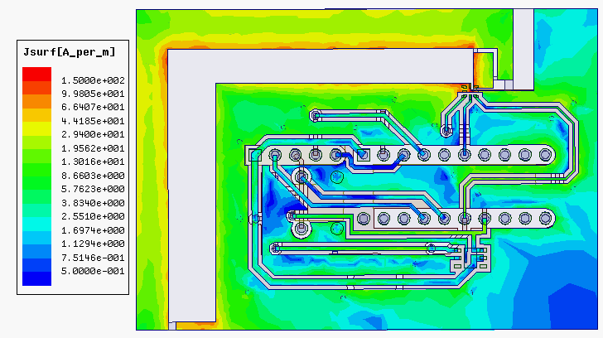
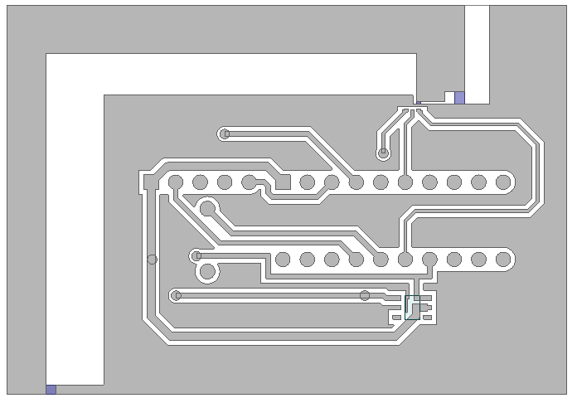
Embedded antenna design
S.-Y. Chen, NTU; shihyuan@ntu.edu.tw
Surface current distribution
y-directed monopole + loop on x-y plane
loop
monopole

Slide 15
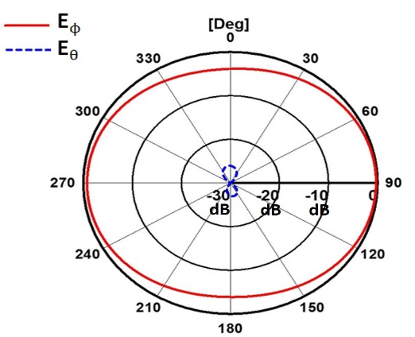
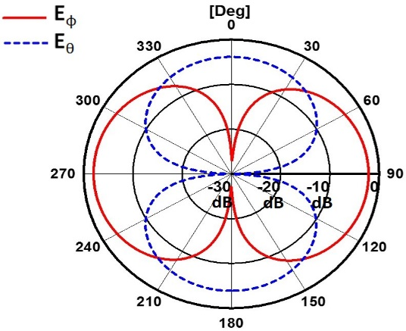
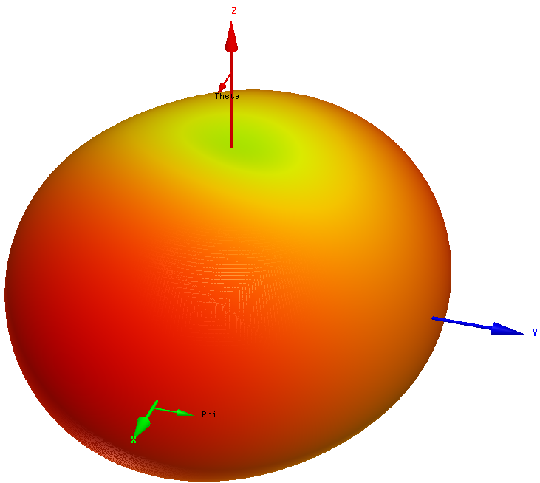
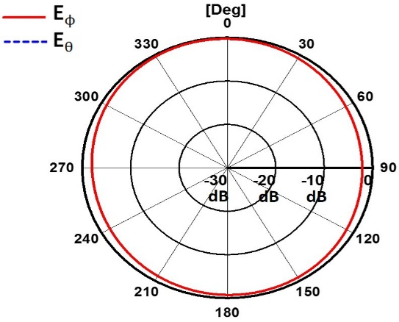
Embedded antenna design
S.-Y. Chen, NTU; shihyuan@ntu.edu.tw
x-z plane
y-directed monopole + loop on x-y plane → omnidirectional w/o nulls
Simulated peak gain: −0.26 dBi
Calculated max. read range: 8 m with 4-W EIRP @ 910 MHz
y-z plane
x-y plane

Slide 16
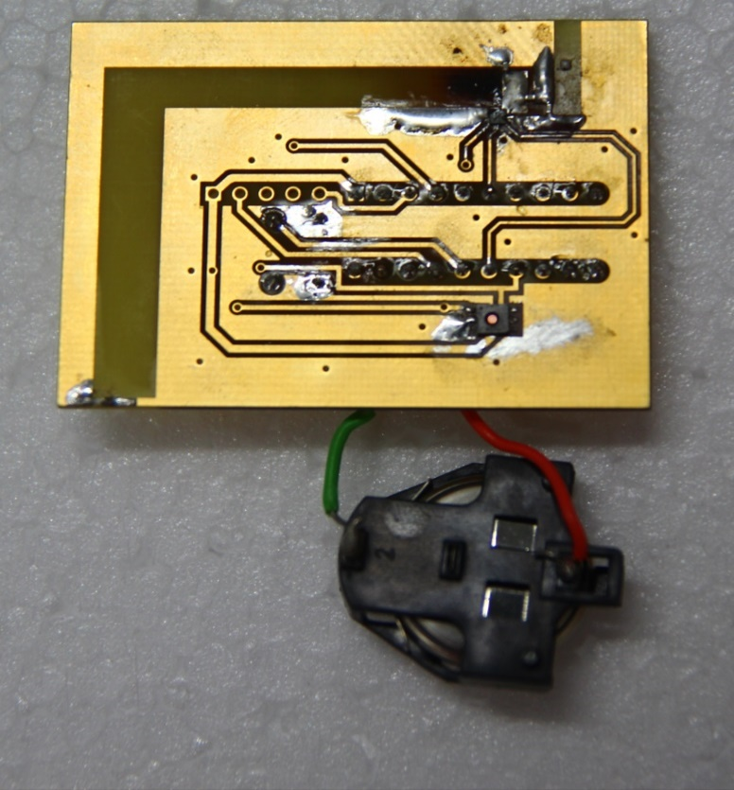
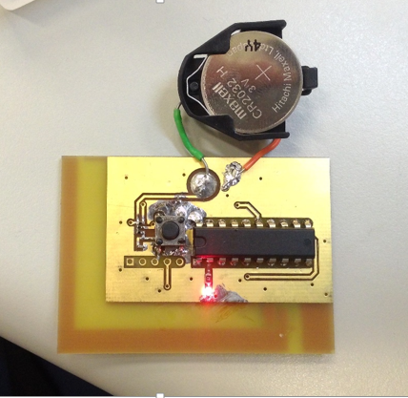
Preliminary measurement results
S.-Y. Chen, NTU; shihyuan@ntu.edu.tw
Fabricated prototype module
Front view
Rear view
LED indicator

Slide 17
Preliminary measurement results
S.-Y. Chen, NTU; shihyuan@ntu.edu.tw
Read range | 3.5 m (measured) / 8 m (calculated)
S_{tag} = −17 dBm, max. EIRP = 36 dBm (4 W), 3-dB polarization mismatch loss (from CP to LP) λ₀ @ 910 MHz = 333.3 mm
Update period | 30 sec | 60 sec | 10 min | 30 min
Battery life (with LED) | 9 days (measured) | 0.6 month (19 day) | 0.5 year (185 day) | 1.5 year (535 day)
Battery life (without LED) | 1.3 year (460 days) | 2.4 year | 13.8 year | 21.3 year
Active (2-sec operation): 15 mA (LED) + 300 uA (MCU) Sleep: 0.9 uA (MCU) Battery in use: Maxwell CR2032 (220 mAh)

Slide 18
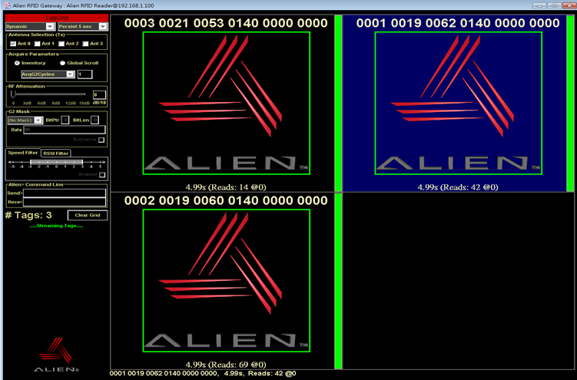
Preliminary measurement results
S.-Y. Chen, NTU; shihyuan@ntu.edu.tw
Serial number
Humidity
Reading multiple modules
Temperature

Slide 19
Conclusions
S.-Y. Chen, NTU; shihyuan@ntu.edu.tw
An integrated wireless sensor module based on passive RFID technology is proposed for use in advanced greenhouses.
Low power consumption
Low cost
Easy for deployment & maintenance
An embedded antenna design based on zero/pole resonances is proposed.
Simple, compact, low-profile, highly integrated
Omnidirectional radiation pattern
Real- and imaginary-parts of Z_{ant} can be independently controlled by C₁ & C₂ to achieve conjugate match.

Slide 20
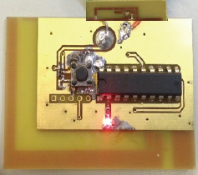
Future outlooks
S.-Y. Chen, NTU; shihyuan@ntu.edu.tw
Include a light sensor to provide illumination information
Optimize the matching condition between our proposed antenna & tag chip for a longer read range
Integrate with energy harvesting submodule to extend the battery life

Slide 21
Thank you!!!
S.-Y. Chen, NTU; shihyuan@ntu.edu.tw
This work is sponsored by Industrial Technology Research Institute (ITRI), Taiwan.
National Taiwan University

